Slide 1







Week 10
TORONTO FC
DATA SECURITY
PLAN
ENSURING CONFIDENTIALITY, INTEGRITY, AND AVAILABILITY OF ENERGY DATA

Slide 2
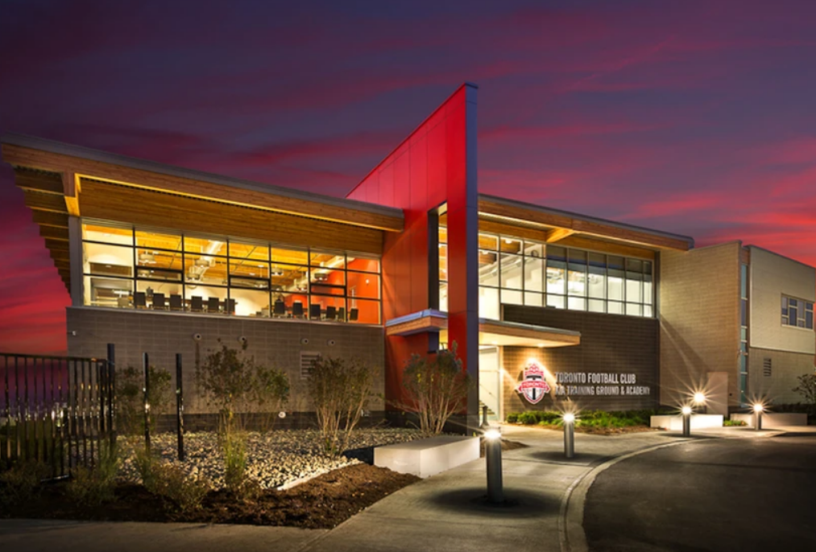
OBJECTIVE
To implement data security solutions that ensure the confidentiality, integrity, and availability of Toronto FC’s energy usage data, in compliance with corporate security policies, ethical standards, and industry regulations.

Slide 3




Task Deliverables
2 Subgroups
Craft Data
Security Plan
Analyze
Extract Insights
on Security Plan
Develop
Rationale
Security Plan
Integrate
rationale to
Toronto FC
Project Portfolio

Slide 4





Team A
Team B
PRESCILA
MORA
CHIBUIKE OKOROAMA
MOHAMED AFTHAB
VENKATA MANISH
KATRAGADDA

Slide 5

Data Security
Plan
Team A
Encryption
Encrypt stored and transmitted energy data
Secure API for facility management systems
Access Control
Role-Based Access for energy data
Multi-factor authentication (MFA)
Confidentiality
Measures
Team B
Data Minimization
Implement retention policies
Secure Communication
Encrypt all data transmission
Secure remote access
Privacy by Design
Regular impact assessments

Slide 6
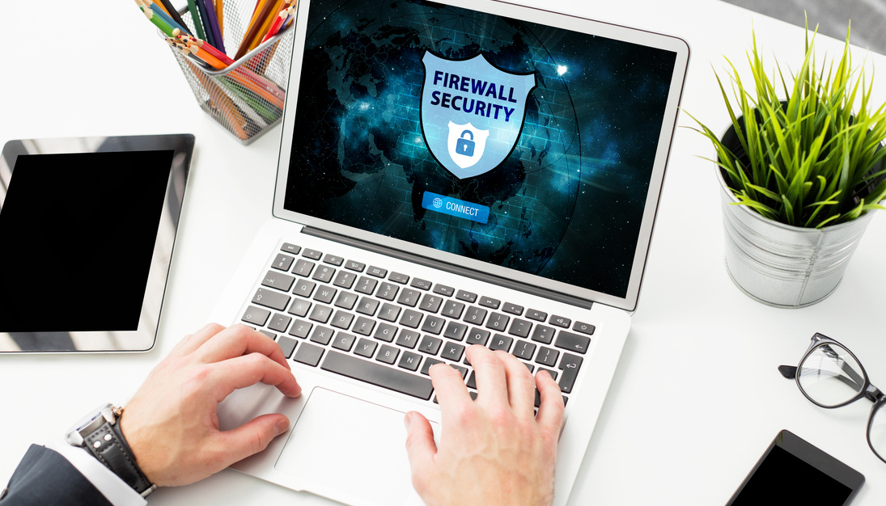
Data Security
Plan
Team A
Data Validation
Check for anomalous usage patterns
Audit Trails
Compliance Monitoring
Track environmental regulation adherence
Team B
Integrity Measures
Data Quality Assurance
Calibrate monitoring equipment
Change Management
Strict system update protocols and version control
Ethical Data Use
Establish ethical policies and staff privacy training

Slide 7

Data Security
Plan
Team A
System Redundancy
Redundant historical data storage
Disaster Recovery
Regular database backups
Establish recovery protocols
Continuous Monitoring
Real-time consumption monitoring
Alert on unexpected usage spikes
Availability Measures
Team B
Scalable Infrastructure (Cloud based)
Incident Response
Plan for potential breaches
Regular system failure drills
Stakeholder Communication

Slide 8




Comprehensive
Security Plan
Enhanced Data Protection
Robust Data Integrity
High Availability & Resilience
Privacy-Centric Approach
Encrypt all energy data (storage & transmission)
Implement role-based access with multi-factor authentication
Anonymize individual usage patterns
Regular equipment calibration and data validation
Comprehensive audit trails and compliance monitoring
Ethical data use policies and staff training
Cloud-based, scalable infrastructure
Redundant systems and regular backups
Real-time monitoring with alert mechanisms
Data minimization and retention policies
Privacy by Design in all systems
Regular privacy impact assessments

Slide 9


Rationale for Security Measures
01
Regulatory Compliance
02
Reputation Management
03
Operational Efficiency
04
Environmental Responsibility
05
Cost Effectiveness

Slide 10







Project Portfolio Integration
Align with Existing Infrastructure
Staff Training Program
Phased Implementation
Performance Metrics
Continuous Improvement
Documentation

Slide 11


RECOMMENDATION
This promotes a balanced approach to energy efficiency and data security, safeguarding privacy while supporting future scalability.
It positions Toronto FC as a leader in secure, sustainable facility management and data ethics, driving innovation and continuous improvement.

Slide 12

THANK YOU
References
National Institute of Standards and Technology (NIST) https://www.nist.gov/
International Association of Venue Managers (IAVM) https://www.iavm.org/
International Organization for Standardization (ISO) https://www.iso.org/
Sports & Leisure Research Group https://sportsandleisureresearch.com/

